Slide 1

Distributional Tests for Supernova Searches
Sophia G. Schwalbe
Michele Zanolin, Marek Szczepanczyk
Embry-Riddle Aeronautical University
NASA Space Grant AZ State Symposium
16 April 2016

Slide 2
Overview
Purpose
Distributional Tests
Background and Foreground
Current Status
Next Steps

Slide 3
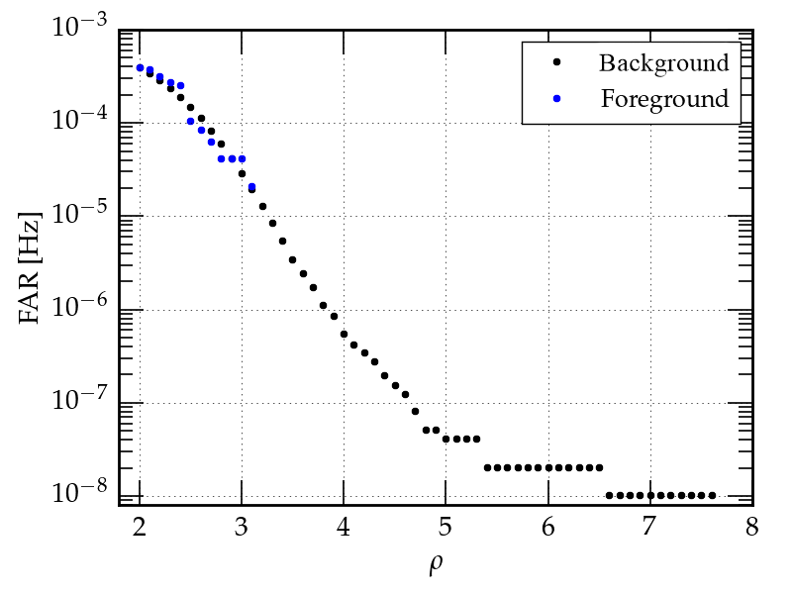
Purpose
Triggers are excess energy from detector data related to Signal-to-Noise ratio (ρ).
Two types of data:
  Foreground: triggers which are gravitational wave candidates.
  Background: noise triggers.
Comparison between Foreground and Background
Current detection relies on only the loudest event of foreground.
Want to use weaker events from foreground in detection.
  Compare background to foreground using distributional tests.
[1] Y. Shi , et al.

Slide 4
Distributional Tests
Distributional tests compare background and foreground to produce a probability that the distributions are compatible.
There are two kinds of distributional tests:
  Parametric: the background distribution has a known analytical shape.
  Non-parametric: no assumptions made on background shape.
In LIGO, we would like to use non-parametric tests.

Slide 5
Non-Parametric Distributional Tests
Need to use single scalar measure (ρ, FAR).
Tests implemented so far:
  Kolmogorov-Smirnov
  Mann-Whitney
  Chi Squared
  Asymmetric Chi Squared

Slide 6
Background and Foreground
One Month Data
Background
Triggers
Distributional Tests
(95% confidence)
Same
Different
One Month Data
Background Triggers
Injections

Slide 7
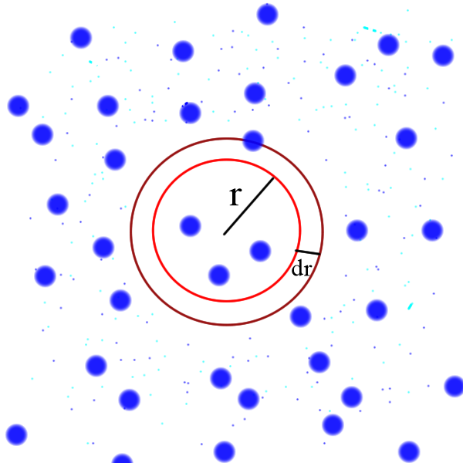


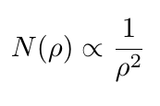
Example of Astrophysical Population Simulation
Random identical supernovae uniformly distributed in space

Slide 8
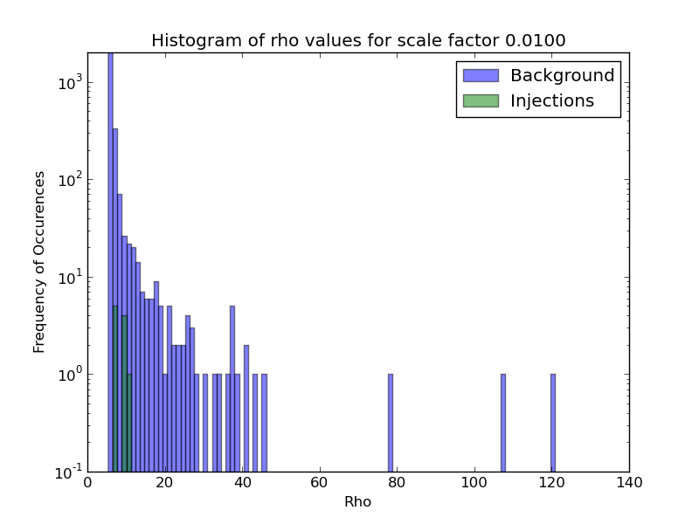
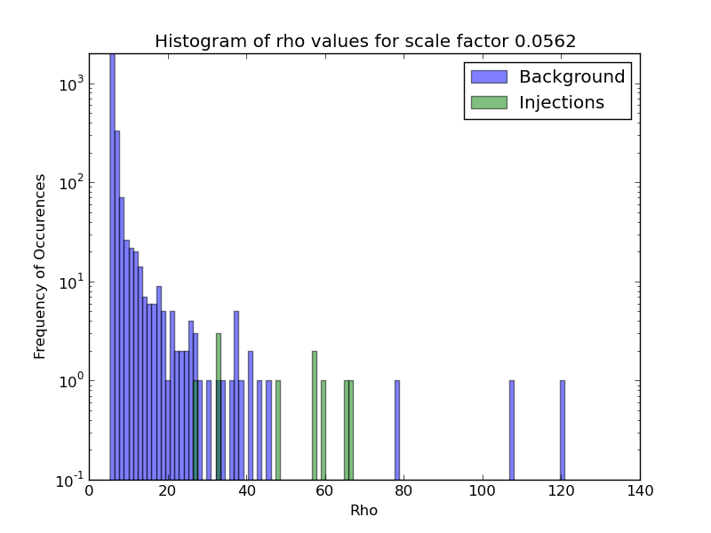
Background and Foreground Distributions
Scale factor indicates how energetic the injections are.

Slide 9
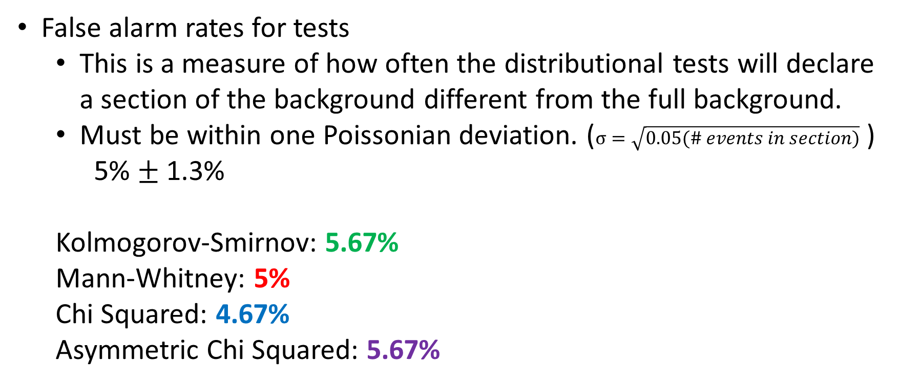
Current Status
False alarm rates for tests
  This is a measure of how often the distributional tests will declare a section of the background different from the full background.
  Must be within one Poissonian deviation. ($σ=\sqrt{0.05(\# events in section)}$ )
    5% $±$ 1.3%
  Kolmogorov-Smirnov: 5.67%
  Mann-Whitney: 5%
  Chi Squared: 4.67%
  Asymmetric Chi Squared: 5.67%

Slide 10
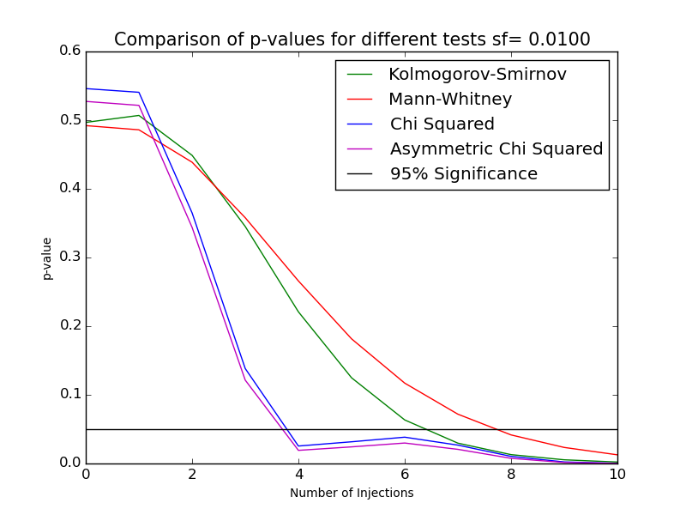
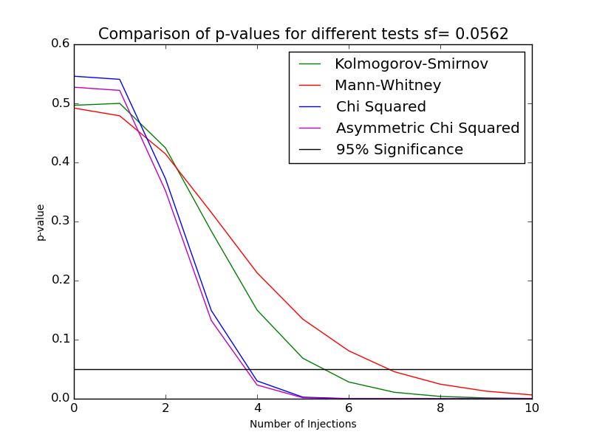
Current Status
Asymmetric Chi Squared most sensitive to least events for high-energy triggers.

Slide 11
Future Populations
Supernovae injections in exact location of optical triggers
Same amplitude repeaters
  Assumes all the triggers have the same parameter
Background-like
  Distribution is exponential under logarithmic scale, where exponential constant is correlated to that of the noise (background) triggers
Galactic center
  Distribution mimics that of distribution of same transients but random polarizations located in galactic center would produce
Power law decay
  Assumes distributions of parameter proportional to negative integer powers

Slide 12
Next Steps
Repeat for different number of triggers, waveforms, and population distributions
Compare tests for different parameters
Compare different lowest frequency cuts in the spectrum
Compare to counting tests

Slide 13
References
[1] Shi, Y., et al. “Non-Parametric Distributional Tests for Gravitational Wave Burst Detection with Comparison to Feldman-Cousins Counting Method”. 23 March 2010.
[2] Stephens, M. A. “Use of the Kolmogorov-Smirnov, Cramer-Von Mises and Related Statistics Without Extensive Tables”. Journal of the Royal Statistical Society. Series B (Methodological), Vol. 32, No. 1. (1970), pp. 115-122.
[3] DeGroot, M. and Schervish, M. Probability and Statistics, 4th Edition. Adison-Wesley. 2012.
[4] Press, W. et al. Numerical Recipes: The Art of Scientific Computing, 3rd Edition. Cambridge University Press. 2007.
[5] Raffai, P., et al. "Optimal networks of future gravitational-wave telescopes“. Classical and Quantum Gravity, Vol. 30, p.155004 (2013) Impact factor: 3.103

